Slide 1
Hot Pursuit
Python with Robots Mission 7
Lesson 1 Objectives 1-3

Slide 2
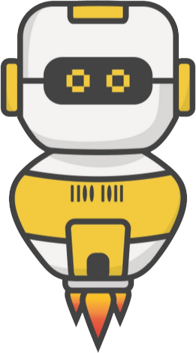
Pre-Mission Warm-Up
In your Mission 7 Lesson 1 log, answer the pre-mission warm-up questions:
How does a line sensor work?
How do you think CodeBot can “see” objects?

Slide 3
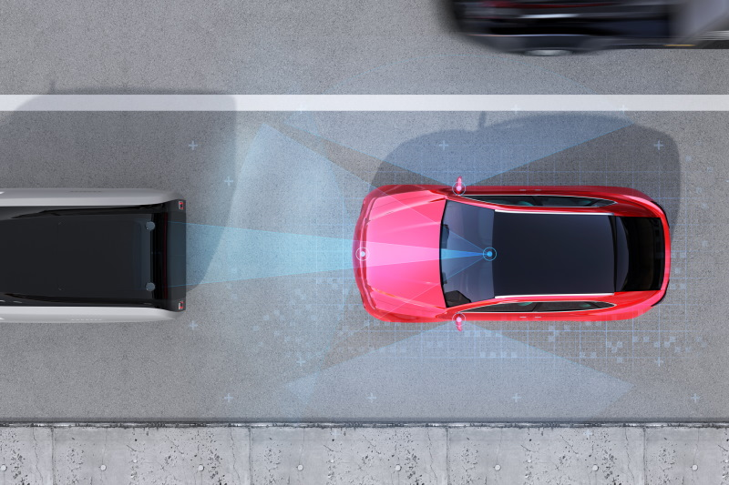
Mission 7: Hot Pursuit
Can CodeBot see objects in its path?
Not exactly.
It doesn’t have a camera.
But it does have an infrared proximity sensor system!
Your ‘bot uses reflected IR light to detect obstacles.

Slide 4
Mission 7: Hot Pursuit
In this project you will:
Go in-depth with the proximity sensors.
Write code to detect, pursue and avoid objects.
These sensors add an awesome new dimension to CodeBot’s capabilities!

Slide 5
Mission 7: Hot Pursuit
Project Goals:
Use the basic proximity sensors detect() function to make a presence detector.
Experiment with light and dark ground-surfaces to find the best emitter power and detection threshold levels for each environment.
Use the range() function to make an interactive display of object reflectivity.

Slide 6
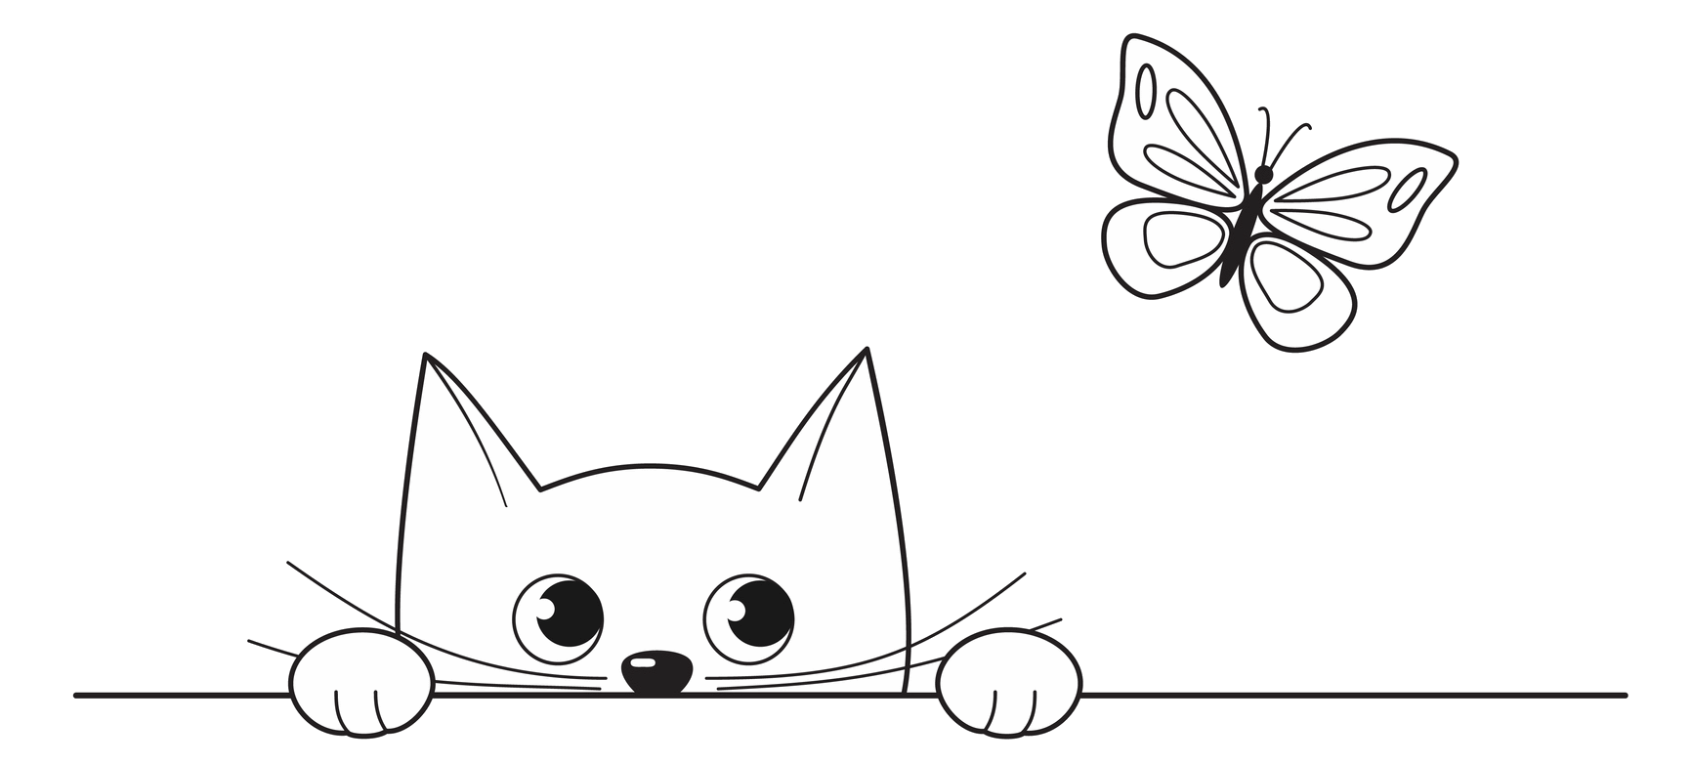
Mission 7: Hot Pursuit
Project Goals:
Write calibration functions so CodeBot can adapt to its environment.
Bring in the motors for a FaceOff challenge.
Code a “Curious Puppy Bot” that will chase a ball around.

Slide 7
Mission 7: Hot Pursuit
For this lesson, we will work on the first three goals:
Use the basic proximity sensors detect() function to make a presence detector.
Experiment with light and dark ground-surfaces to find the best emitter power and detection threshold levels for each environment.
Use the range() function to make an interactive display of object reflectivity.

Slide 8
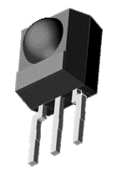
Objective #1: Presence Detector
The proximity sensors on CodeBot’s front corners detect infrared (IR) light that bounces back from objects in its path.
Each sensor is covered by a visor so most of the incoming light comes from straight ahead.
The visor shades the sensor from IR in sunlight and overhead lights.
It also blocks some reflections from the ground and objects to the sides.

Slide 9
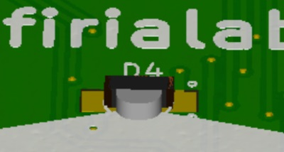
Objective #1: Presence Detector
The source of the infrared light is the LED emitter behind Line Sensor LED #2.
Like a bright “headlight”, it lights up objects in front of your ‘bot.

Slide 10
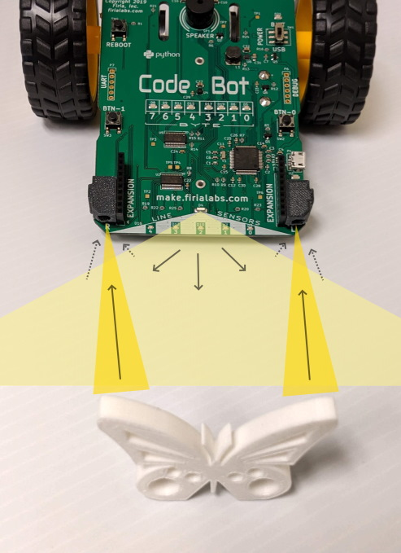
Objective #1: Presence Detector
Notice the picture.
The LED emitter emits light, and the sensors detect it.
Most of the light reflected back into the sensors is from the butterfly.
But there is also some light bouncing off the ground into the sensors.

Slide 11
Objective #1: Presence Detector
Use the function prox.detect() to detect reflected light from each sensor.
It returns a tuple of two bool values.
Using the picture as an example, the function will return the tuple (True, True).

Slide 12

Objective #1: Presence Detector
If an object was only in front of the left proximity sensor but not the right sensor, it would return (True, False).
This tuple can be used to turn on/off the amber LEDs under each sensor:

Slide 13
Objective #1 Activity
DO THIS:
Start a new file – HotPursuit
Follow CodeTrek to write the code, or use the code on the next slide.

Slide 14
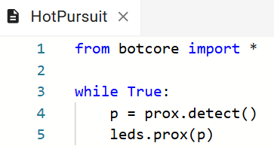
Objective #1 Activity
HotPursuit code:

Slide 15
Objective #1 Activity
DO THIS:
Place CodeBot on a dark surface.
Run the code.
Watch the amber LED turn on when an object is close to the sensor and off when there isn’t an object.

Slide 16
Objective #1 Activity
DO THIS:
Place CodeBot on a white or light surface, like a piece of paper.
Run the code.
What happens? Write your answer in the mission log.

Slide 17
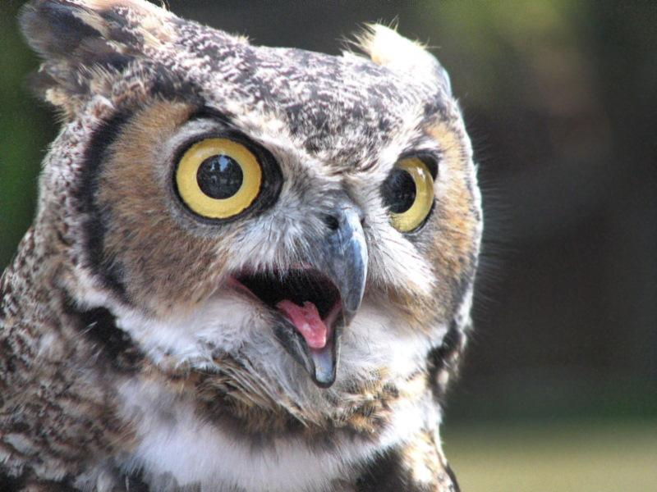
Objective #2: Power and Sensitivity
The prox.detect() function is nice!
But it has limitations.
It is too sensitive when the ‘bot is on a white surface.
On a black surface or open space you need extra sensitivity.

Slide 18
Objective #2: Power and Sensitivity
Be the ‘Bot
In each situation, you need different power for the light and sensitivity for the detecting.
You can set the power and detection threshold when using the prox.detect() function.

Slide 19
Objective #2: Power and Sensitivity
More control with parameters for prox.detect()
The prox.detect() function actually has two optional parameters.
The parameters are (power, threshold)
If you don’t use any arguments when calling the function, the function uses: prox.detect(1, 100)
This means low power and maximum sensitivity!
But you can set your own power and threshold.

Slide 20
Objective #2: Power and Sensitivity
Power
An emitter power level goes from 1 to 8.
It controls the brightness of the IR being emitted.
Power level 1 | Low power (dim)
Power level 8 | High power (bright)

Slide 21
Objective #2: Power and Sensitivity
Detection Threshold
The detection sensitivity ranges from 0% to 100%.
It controls how much light is needed for a True detection.
Detection Threshold | Sensitivity Level
0% | Minimum
100% | Maximum

Slide 22
Objective #2 Activity
DO THIS:
Follow CodeTrek to modify the code, or use the code on the next slide.
Use a variable to set the power to minimum.
Use another variable to set the threshold to medium-high sensitivity.
Use the variables as arguments with the function call.

Slide 23
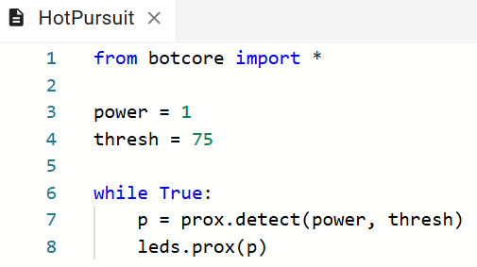
Objective #2 Activity
HotPursuit code:

Slide 24
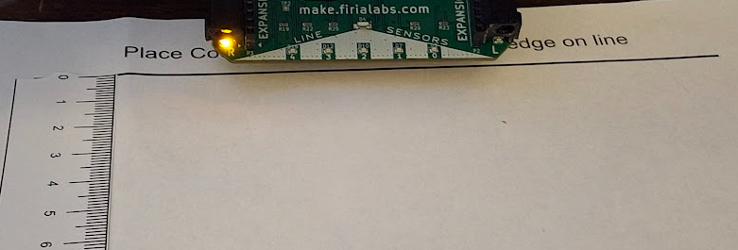
Objective #2 Activity
DO THIS:
Place CodeBot on a white surface with a ruler.
Run the code with the current values.

Slide 25
Objective #2 Activity
DO THIS:
Record the distance needed to detect an object, like your finger or school ID.
Adjust the power and threshold several times and record your findings in the mission log.
Your log might look similar to the one on the next slide.
NOTE: Each ‘bot and sensor will be a little different.

Slide 26
Objective #2 Activity
Sample Mission Log Table:
Power | Thresh | Left Distance | Right Distance
1 | 75 | 6.5 cm | True
5 | 50 | True | True
2 | 50 | 9 cm | True
1 | 25 | 4 cm | 5 cm
1 | 40 | 10 cm | 9 cm

Slide 27
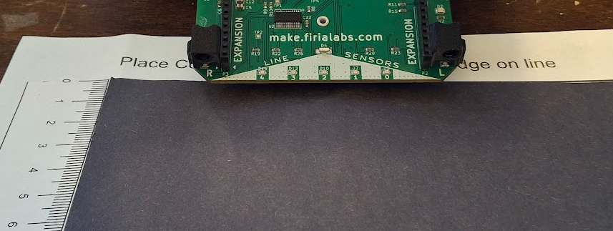
Objective #2 Activity
DO THIS:
Cover the white surface with a black surface, keeping the ruler visible.

Slide 28
Objective #2 Activity
DO THIS:
Run the code with the original values.
Record the distance needed to detect an object, like your finger or school ID.
Adjust the power and threshold several times and record your findings in the mission log.

Slide 29
Objective #2 Activity
DO THIS:
OPTIONAL
Face the ‘bot up so the proximity sensors aren’t on any surface.
Try different power and thresh values to see how close you need to move an object for detection.

Slide 30

Objective #3: Range Scanning
A new function!
The prox.detect() function lets you adapt to different environments.
But it takes a lot of experimentation to arrive at the ideal combination of power and thresh for a given surface.
There is another function that makes it much easier!

Slide 31
Objective #3: Range Scanning
Concept: prox.range()
This function scans multiple sensitivity levels to find the lowest detection threshold where IR reflection is detected.
It has four optional parameters.
prox.range(num_samples, power, range_low, range_high)

Slide 32
Objective #3: Range Scanning
Concept: prox.range()
prox.range(num_samples, power, range_low, range_high)
Num_samples
How many different sensitivity levels to try.
Can range from 1 to 10.
The default number is 4.
Power
Emitter power level for the scan.
Can range from 1 to 8.
The default number is 1.

Slide 33
Objective #3: Range Scanning
Concept: prox.range()
prox.range(num_samples, power, range_low, range_high)
Range_low
Lowest sensitivity range for scan.
Can range from 0% to 100%
The default number is 0.
Range_high
Highest sensitivity range for scan.
Can range from 0% to 100%
The default number is 100.

Slide 34
Objective #3: Range Scanning
Concept: prox.range()
prox.range(num_samples, power, range_low, range_high)
Return value
The function returns the detection threshold values 0-100%.
The return value will be a tuple (left_thresh, right_thresh).
If no reflection is detected, the return value will be (-1, -1).
We will not use the range_low or range_high parameters for this objective.

Slide 35

Objective #3 Activity
DO THIS:
Open the Console Panel
Make sure you are at the bottom of the window.
Type this command, and press <enter>.

Slide 36
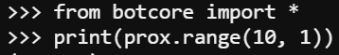
Objective #3 Activity
DO THIS:
Place CodeBot on a white surface.
Type this command and press <enter>.
Record your results in the mission log.

Slide 37
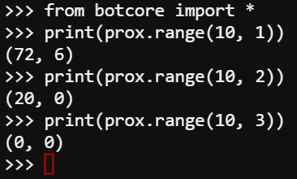
Objective #3 Activity
DO THIS:
Use the up arrow to repeat the command.
Change the power setting.
Record your results in the mission log.
Repeat several times with different power settings.

Slide 38
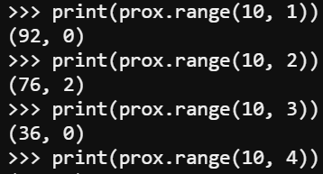
Objective #3 Activity
DO THIS:
Place CodeBot on a black surface.
Repeat the command several times, starting with 1 for the power.
Record your results in the mission log.

Slide 39
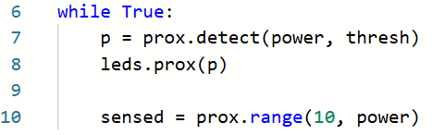
Objective #3 Activity
DO THIS:
You should have one of the two goals completed.
Add this line of code to your program.
Then run the code to check off both goals.

Slide 40

Extensions
Do a “File-Save As” and then change the while True: loop to cycle through the power range and print the results on the console.
Try different shades of surface and compare the results.
Point the ‘bot in the air and see the results.

Slide 41
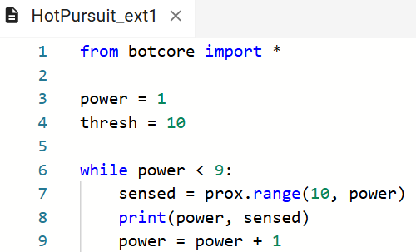
Extensions

Slide 42
Post-Mission Reflection
Complete the post-mission reflection in your Mission 7 Lesson 1 Log:
How does a proximity sensor work?
What is the difference between prox.detect() and prox.range()?

